Slide 1

Bayesian Data Analysis for REACH
2nd Global 21cm Workshop 2019
Dominic Anstey
PhD Student
Notes:
Hello. My name is Dominic and I work on the REACH collaboration under Eloy de Lera Acedo.
I work primarily on developing the data analysis techniques and pipeline for REACH and I’d like to talk about some work I’ve been doing on modelling and correcting for chromatic distortions of antennae in Global 21cm experiments.
REACH’s data analysis uses detailed physically motivated models of the foregrounds, antenna and the 21cm itself in the data fitting, which is done in a Bayesian framework.

Slide 2
Bayesian Analysis
PolyChord – Bayesian Nested Sampling Algorithm (Handley, Hobson & Lasenby 2015)
Model comparison through Bayesian Evidence
Ranking parameter evaluation speeds
Notes:
The Bayesian data analysis tool we use in REACH is PolyChord. This is a nested sampling algorithm developed by Will Handley, Mike Hobson and Anthony Lasenby at the University of Cambridge for use in analysing Planck data. As a nested sampling algorithm, it allows easy calculation of the Bayesian evidence, which allows various different models of the foregrounds and 21cm signal to be compared. It also is able to rank parameters based on speed of evaluation, and sample them accordingly, which is very useful when fitting with detailed physical models that may take some time to calculate.

Slide 3
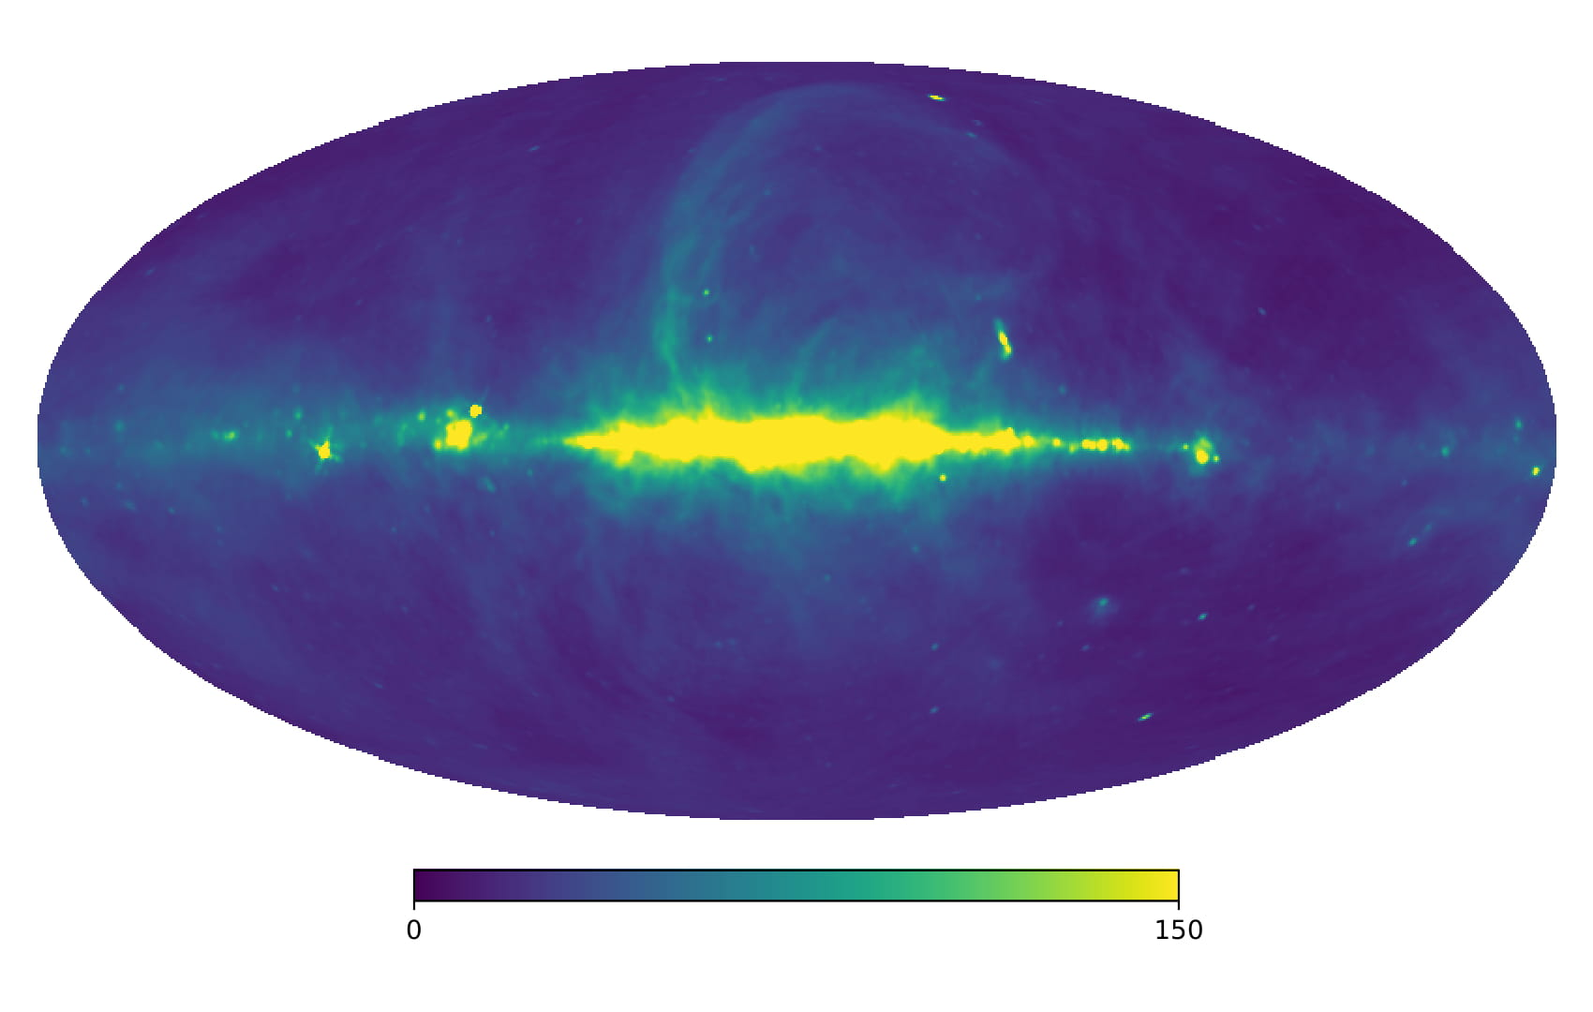
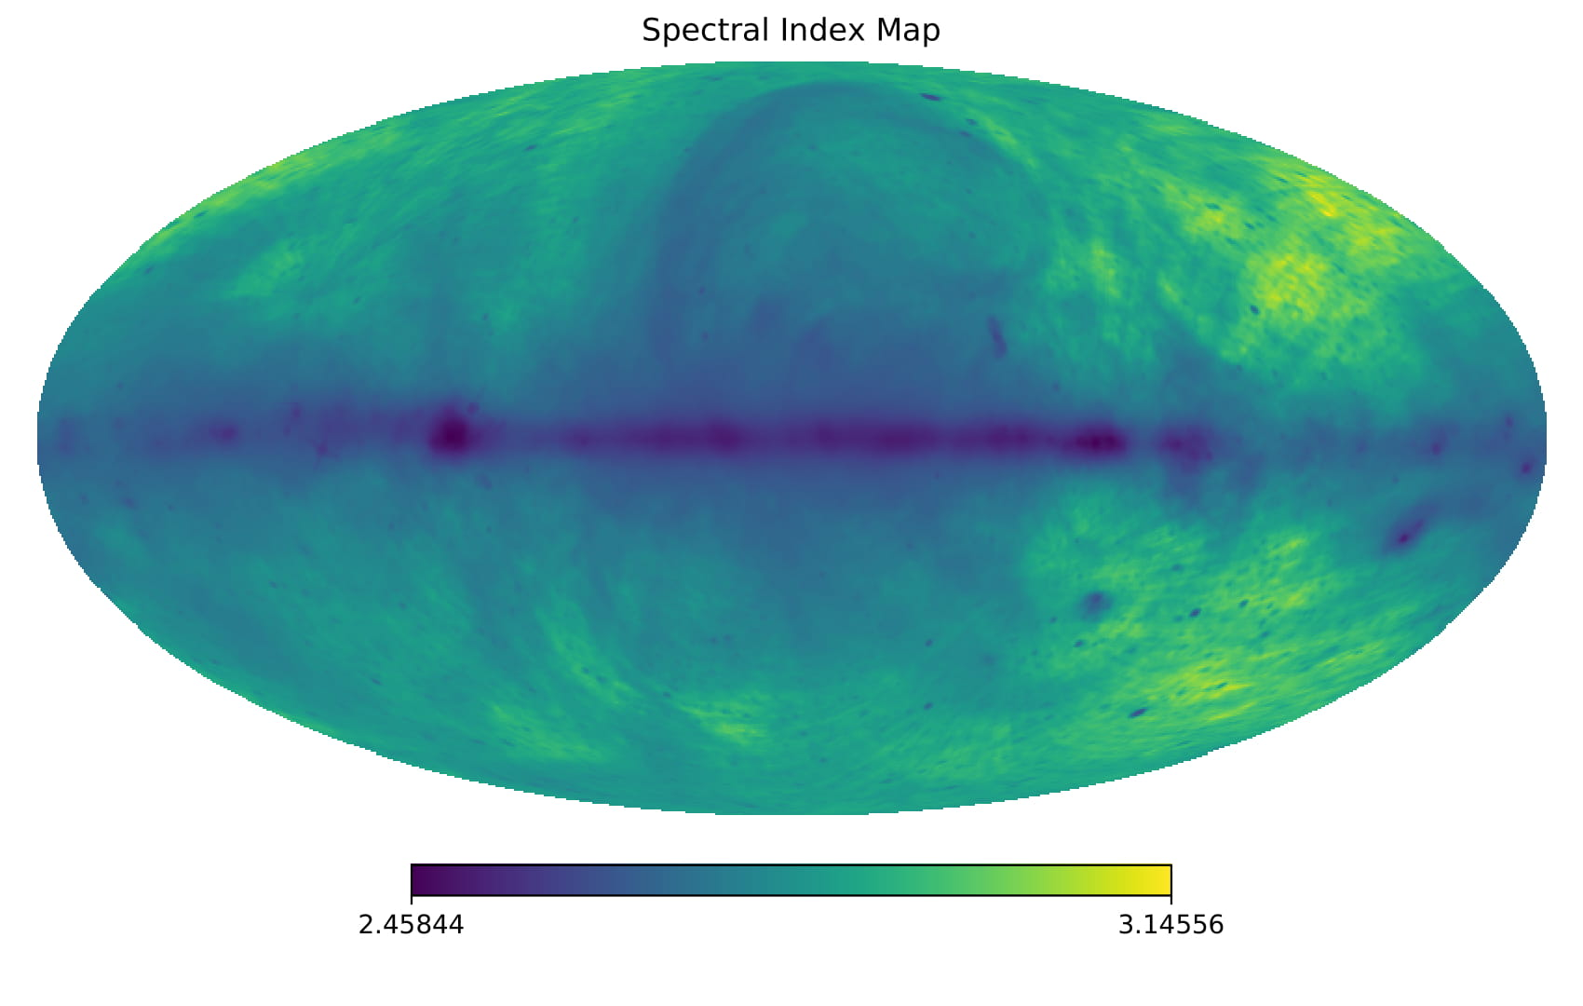
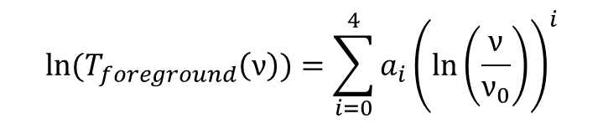
Varying B sky model
K
$${ln⁡(T}_{foreground}\left(ν\right))=\sum_{i=0}^{4}{a_{i}{\left(ln⁡\left(\frac{ν}{ν_{0}}\right)\right)}^{i}}$$
Remazeilles et al. 2015
de Oliveira-Costa et al 2008
Notes:
The typical method for distinguishing the 21cm signal from the foregrounds based on spectral differences; the foregrounds should be spectrally smooth . Therefore, the foregrounds fit to a smooth function. However, there are two effects that can change the foreground structure. First, when the antenna beam is chromatic, it couples spacial variations of power in the sky into the frequency domain and produces non-smooth structures. Second, the spectral index is not uniform across the sky (see spectral index map). Therefore, not only does antenna chromaticity couple spacial variation into the frequency domain, but the spacial distribution it couples is also changing in frequency. These two effects combine in a very complex, non-trivial fashion.
I characterised what effects chromaticity and spectral index variation can have by generating simulated observation data by scaling a base map (Reprocessed Haslam) pixelwise by a spectral index map (which I generated from the reprocessed Haslam and De Oliveria Costa GSM) and convolving it with a simulated antenna beam. I then tried fitting this with a smooth, 5-term log polynomial model.

Slide 4
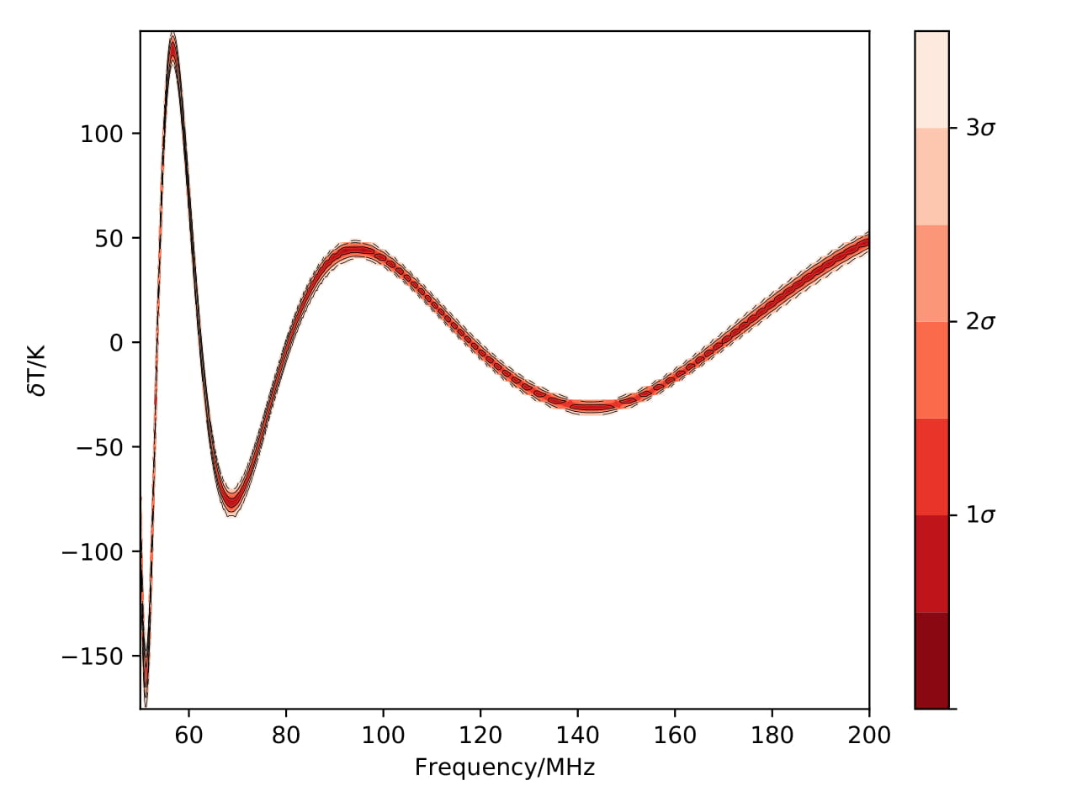
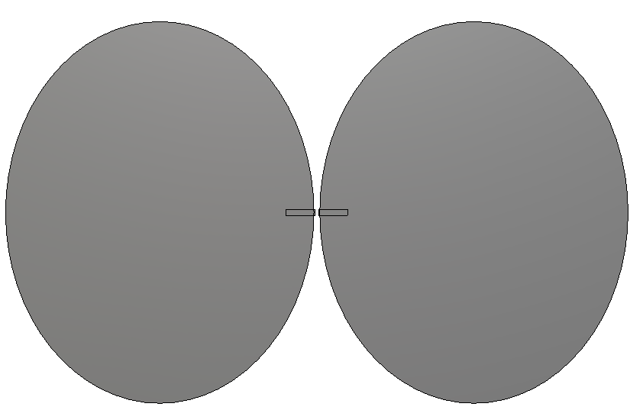
Elliptical Dipole Antenna
Antenna designs not finalised
Antenna patterns and images provided by John Cumner and Quentin Gueuning
Anstey et al. 2019, in prep.
Notes:
This shows the residual after subtracting the best fit foreground model for a simple elliptical dipole. This model has the fit over the entire wide frequency range where the 21cm signal could be, 50-200MHz, showing significant residual structure. I tried this for a wide range of antenna types.

Slide 5
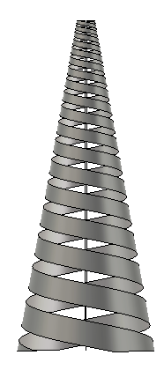
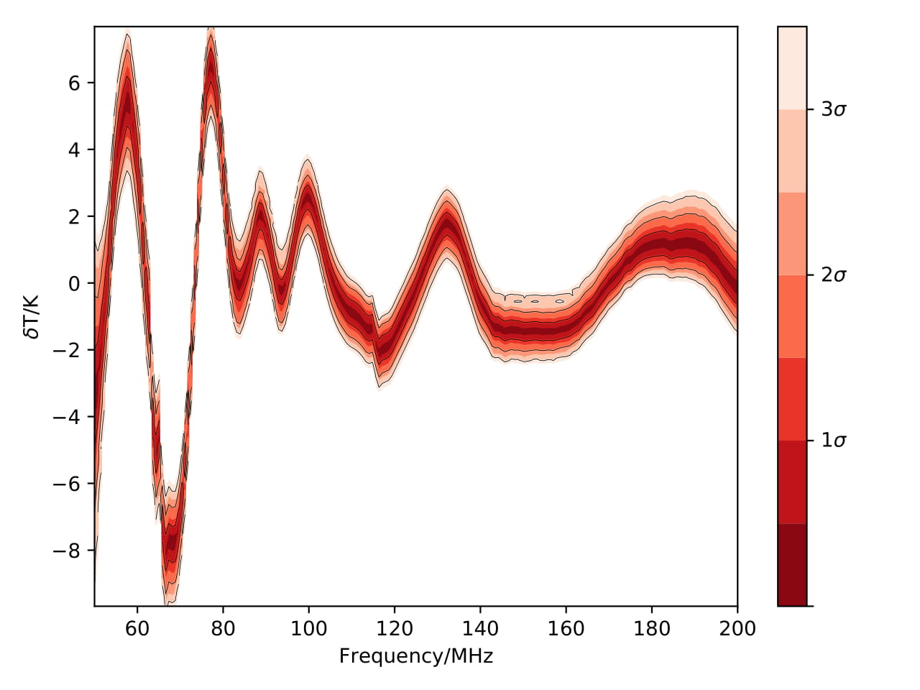
Log Spiral Antenna
Antenna designs not finalised
Antenna patterns and images provided by John Cumner and Quentin Gueuning
Anstey et al. 2019, in prep.
Notes:
This shows the same effect for a conical log spiral antenna.

Slide 6
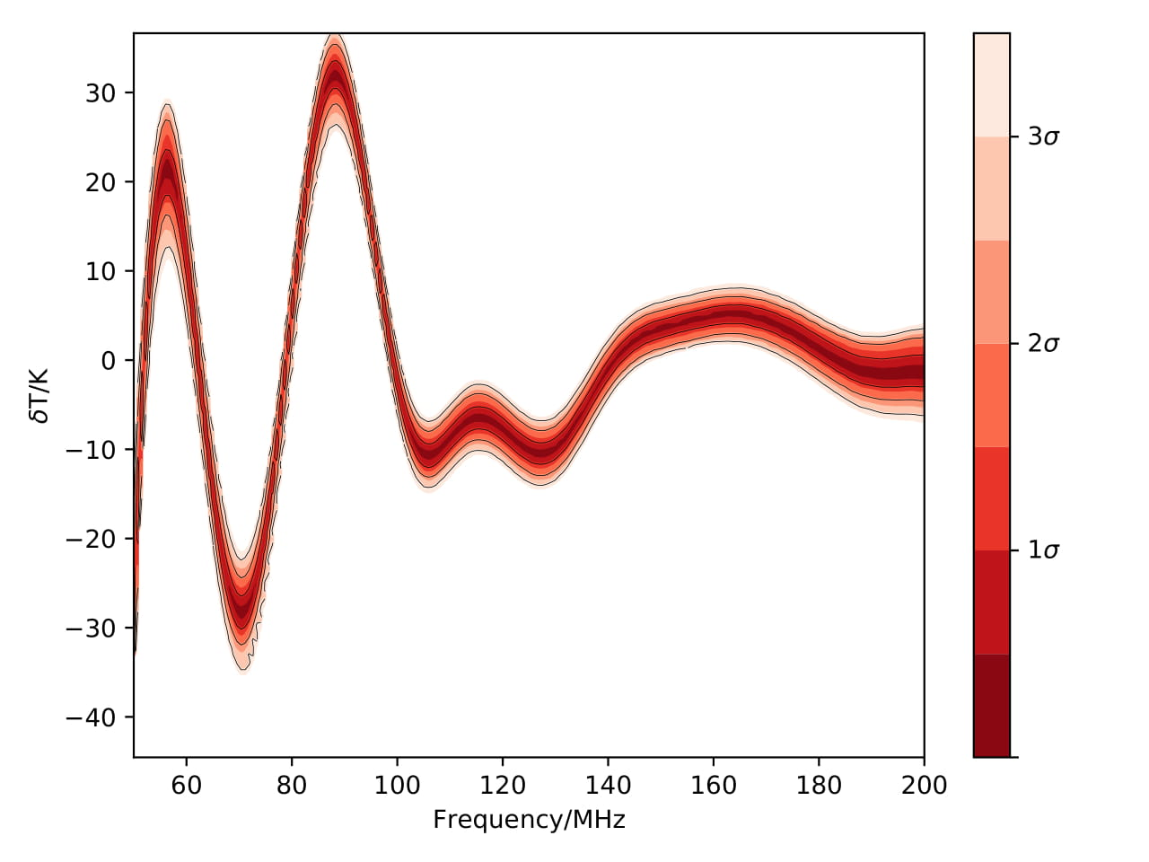
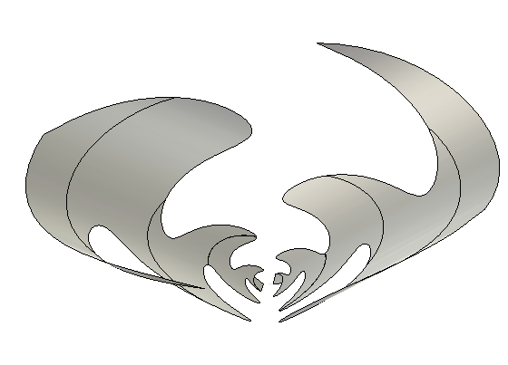
Conical Sinuous Antenna
Antenna designs not finalised
Antenna patterns and images provided by John Cumner and Quentin Gueuning
Anstey et al. 2019, in prep.
Notes:
This show the results for a conical log spiral. These chromatic distortions clearly greatly exceed the 21cm signal magnitude and show a very similar, distinctly not smooth, spectral characteristic. This means if they are not properly accounted for, it will be extremely difficult to identify the 21cm signal.

Slide 7
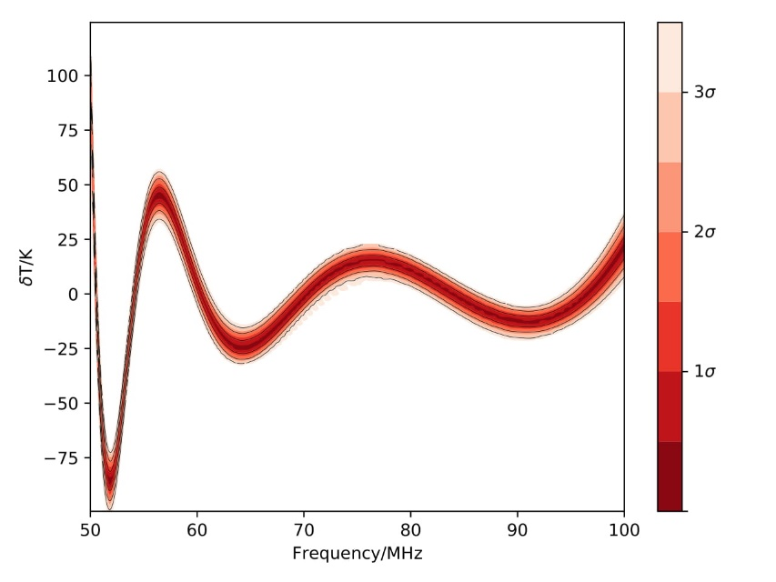
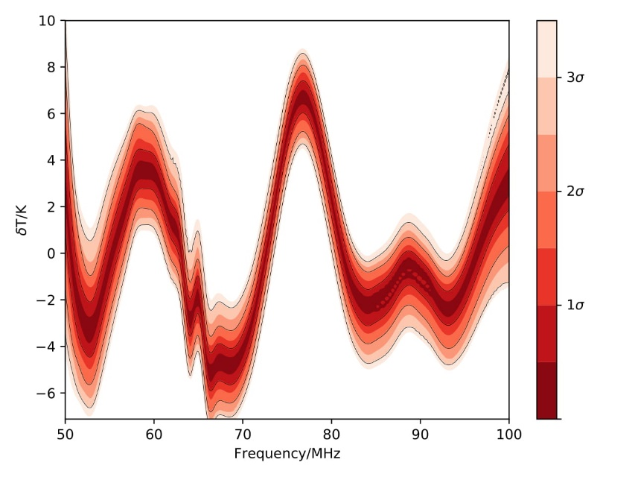
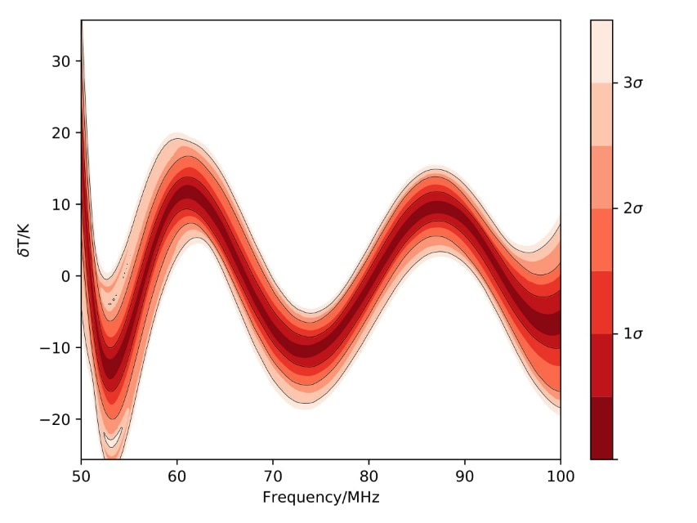
Narrow Frequency Band
Elliptical Dipole
Log Spiral
Conical Sinuous
Anstey et al. 2019, in prep.
Notes:
The effects of chromaticity are obviously mitigated slightly by observing over a narrow frequency band, but they are still significant enough even for a very simple smooth antenna like a dipole, to overwhelm the 21cm signal.

Slide 8
General Modelling Protocol
Generate a parameterised model of the entire sky across the whole frequency range
Generate a parameterised model of the antenna pattern
Fit a foreground model of the convolution of the pattern model with the sky model
Notes:
These distortions have to be accounted for. The method I have designed for REACH is to effectively fit a parameterised sky simulation as the foreground model. does this by generating a parameterised sky map across the frequency range and a parameterised model of the beam, and taking the convolution of the two as the foreground model thus fitting for the physical parameters of both models. There are two main benefits to doing this. First, it allows you to account for varying spectral index in the foreground map. Second, it makes the chromatic distortion become part of the foreground model, so that they can be fit based on observed data.
The parameterised modelling of the antenna pattern is not yet implemented, so for the rest of the analysis, it is assumed that the antenna pattern is known exactly. The modelling of the sky is then done as follows:

Slide 9
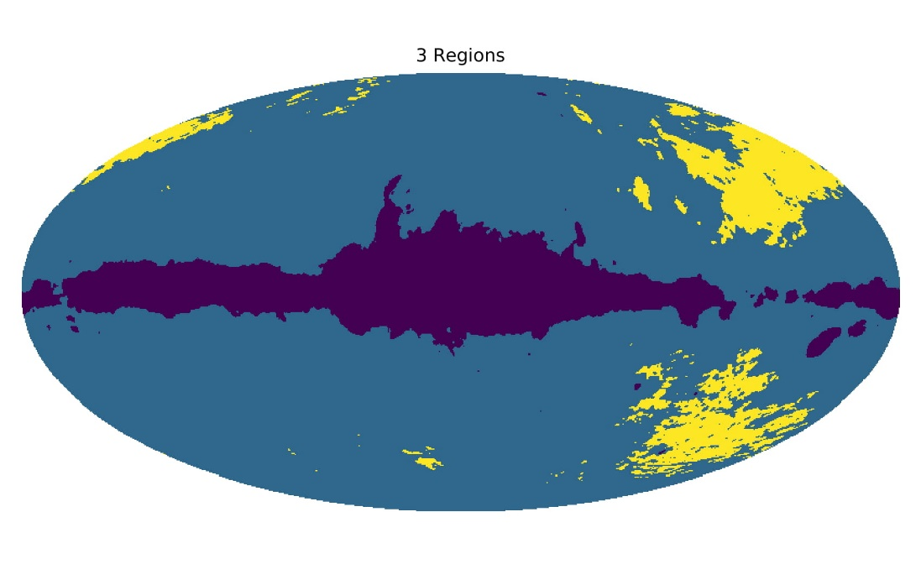
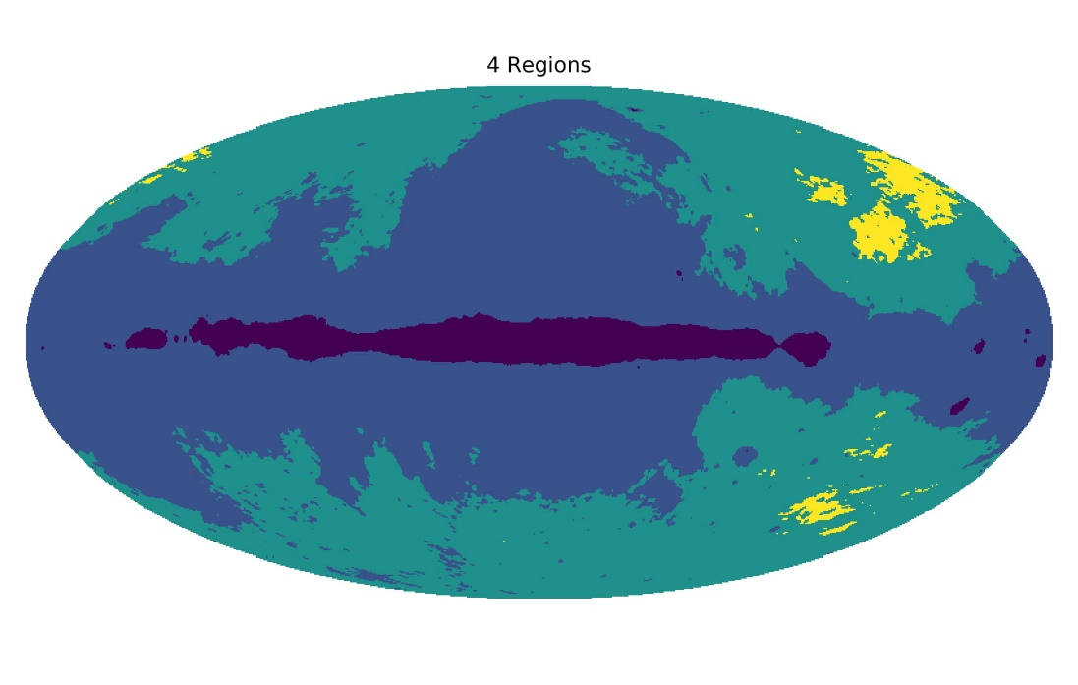
Sky Division
Anstey et al. 2019, in prep.
Notes:
First, variation in spectral index need to be modelled. the sky is divided up into some number of regions, within which the spectral indices are broadly similar. The more regions that are used, the smaller the variation within each. This allows a more detailed description of the spectral index variation, at the cost of requiring more parameters. Here I show the division into 3 and 4 regions, based on the spectral index map I showed earlier.

Slide 10
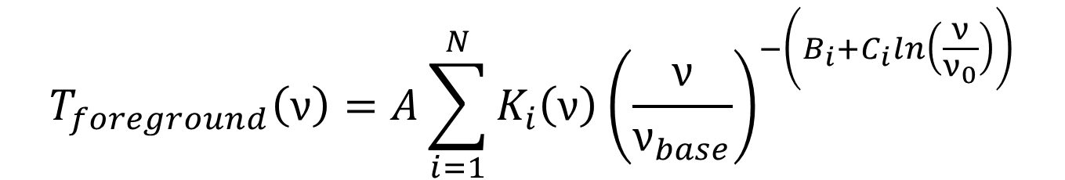
Foreground Model Function
$$K_{i}\left(ν\right)= \frac{1}{4π}\int_{sky}^{ }{G\left(θ,φ,ν\right)M_{i}\left(θ,φ\right)\int_{time}^{ }{\left[T_{base}\left(θ,φ\right) − T_{CMB}\right]}}ⅆtdΩ$$
$$T_{foreground}\left(ν\right)=A\sum_{i=1}^{N}{K_{i}\left(ν\right){\left(\frac{ν}{ν_{base}}\right)}^{−\left(B_{i}+C_{i}ln\left(\frac{ν}{ν_{0}}\right)\right)}}$$
Anstey et al. 2019, in prep.
Notes:
Then a base map can be chosen. I use Haslam but there is very little dependency on what specific base map is used. Each defined region of the sky can be isolated from this base map, M_i in this equation is a mask of the sky region, and convolved with a model of the antenna pattern at every frequency, as well as integrated over the observing time. This produces a chromaticity functions for each region of the sky.

Slide 11
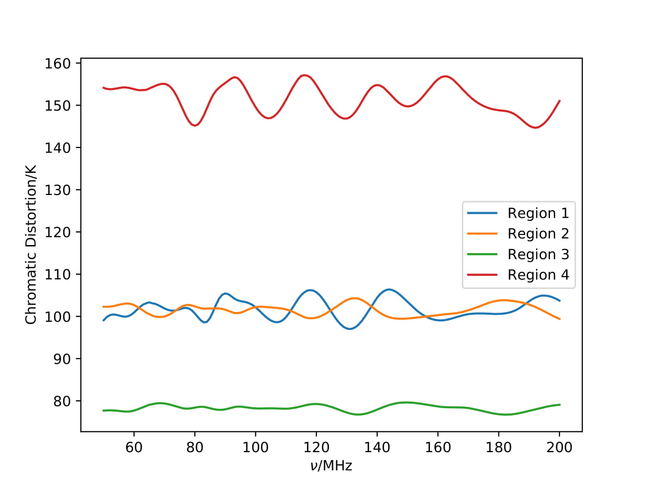
Chromatic Functions
Anstey et al. 2019, in prep.
Notes:
These are the chromatic functions of a log spiral antenna when the sky is divided into 4 regions.

Slide 12
Foreground Model Function
$$K_{i}\left(ν\right)= \frac{1}{4π}\int_{sky}^{ }{G\left(θ,φ,ν\right)M_{i}\left(θ,φ\right)\int_{time}^{ }{\left[T_{base}\left(θ,φ\right) − T_{CMB}\right]}}ⅆtdΩ$$
$$T_{foreground}\left(ν\right)=A\sum_{i=1}^{N}{K_{i}\left(ν\right){\left(\frac{ν}{ν_{base}}\right)}^{−\left(B_{i}+C_{i}ln\left(\frac{ν}{ν_{0}}\right)\right)}}$$
Anstey et al. 2019, in prep.
Notes:
These chromatic functions can the be multiplied by a parameterised running power law and summed to produce a 2N+1 parameter model that can be fit as a foreground model that includes both the antenna distortion and the spectral index variation.

Slide 13

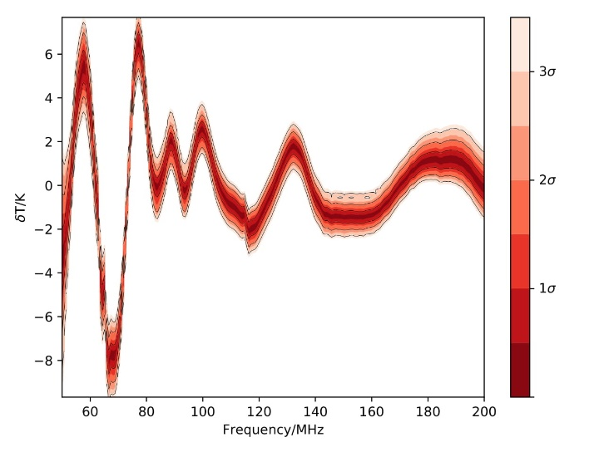
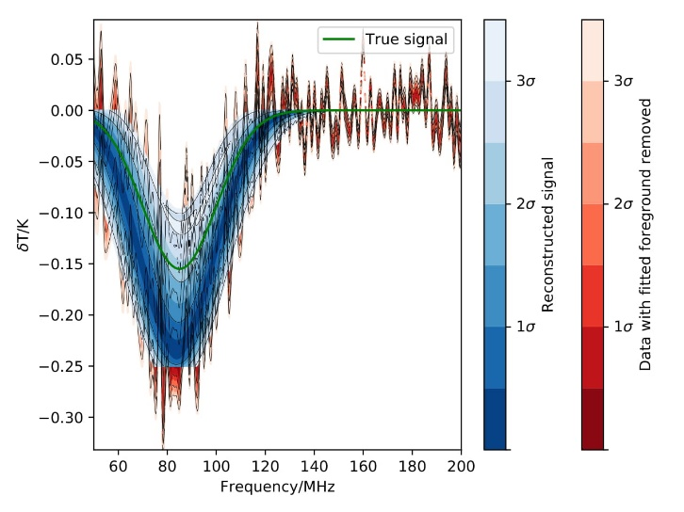
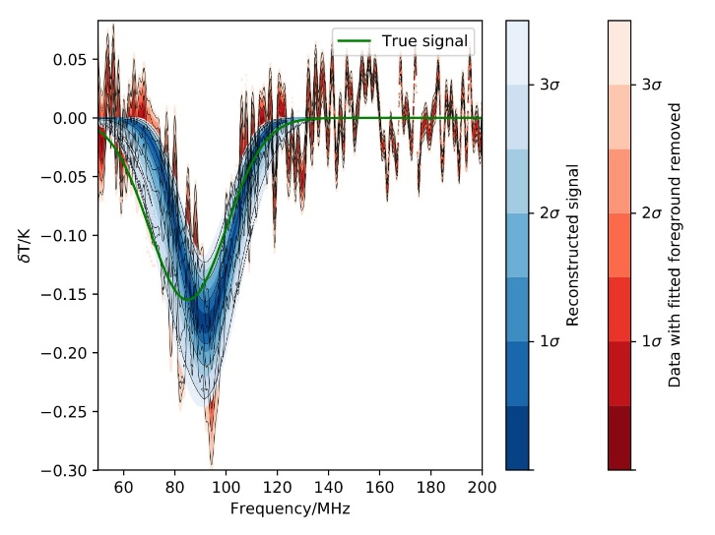
Results
Elliptical Dipole
Log Spiral
Anstey et al. 2019, in prep.
Notes:
I found this to be highly effective at correcting for chromatic distortions provided the antenna is not too strongly chromatic, or that it’s distortions are quite regular. These results show the effect of fitting the same data sets as before, with mock 21cm signals injected at 85Mhz centre frequency, fit using this method with 4 sky regions, as opposed to a 5-term log polynomial. The process is able to correct for the distortions sufficiently as to allow the 21cm signal to be clearly identified. For these two antennae, this worked over all the parameter space. I repeated this analysis for signals injected of varying centre frequency and amplitude. Both were successful across the frequency band and down to ~100 mK for the elliptical dipole and ~40mK for the log spiral.

Slide 14
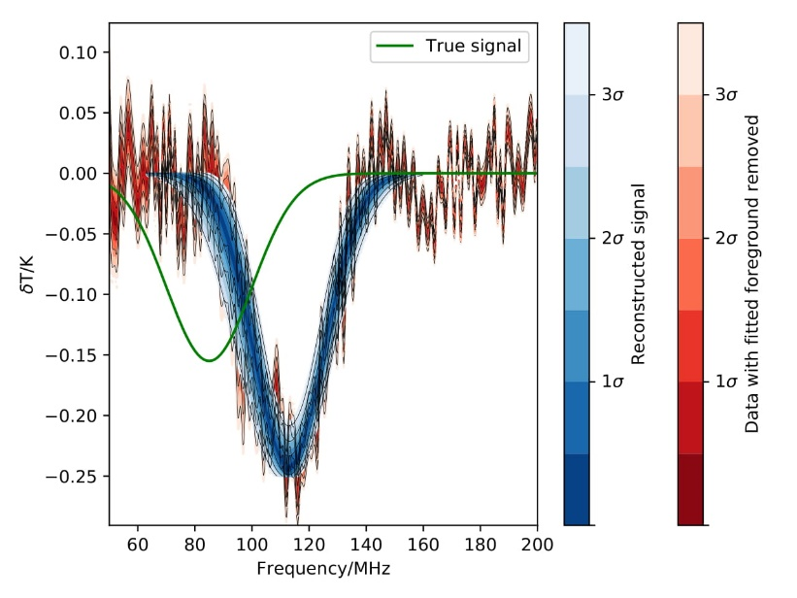
Inefficiencies
Conical Sinuous Antenna
Notes:
This technique does have limits. It cannot correct for any chromaticity. I haven’t yet mentioned the conical sinuous antenna. This had the strongest and least simple chromaticity. It’s beam splits into 4 lobes that rotate around zenith. These are the results for 4 sky regions, and the 21cm signal fails to be properly identified.

Slide 15
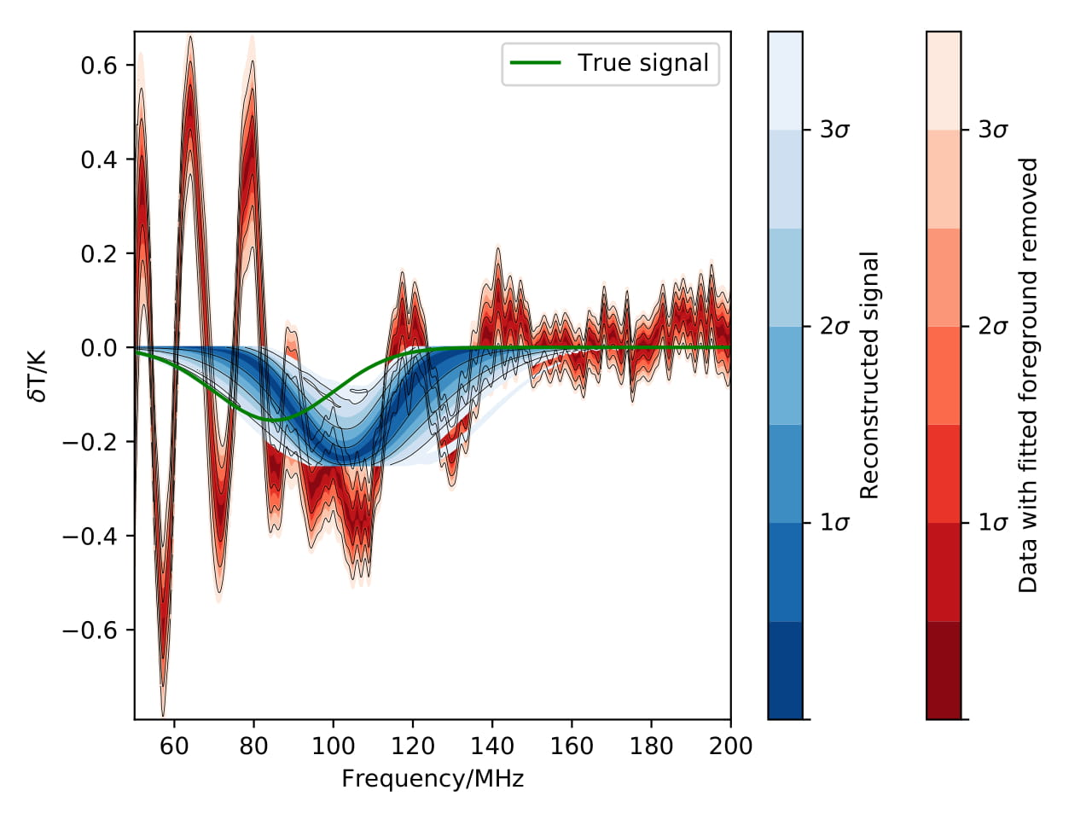
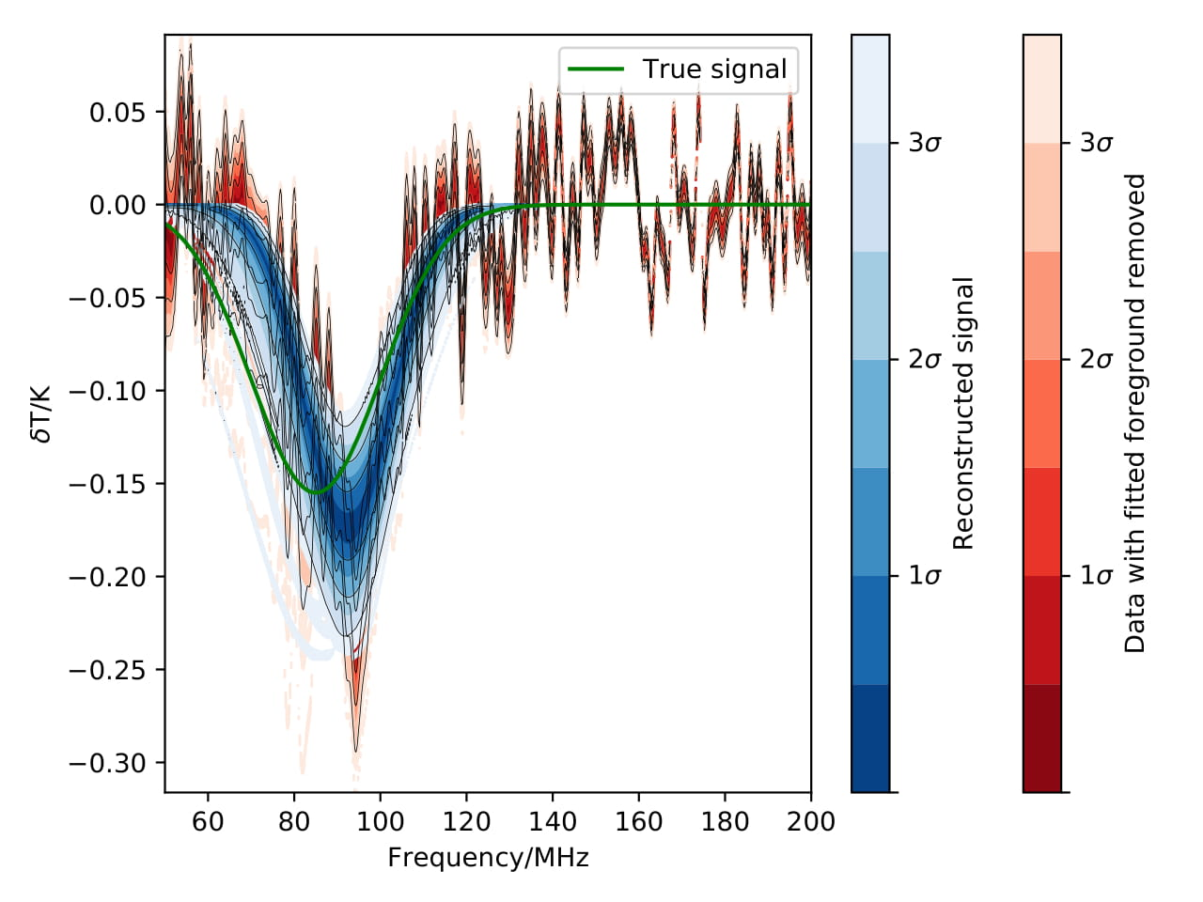
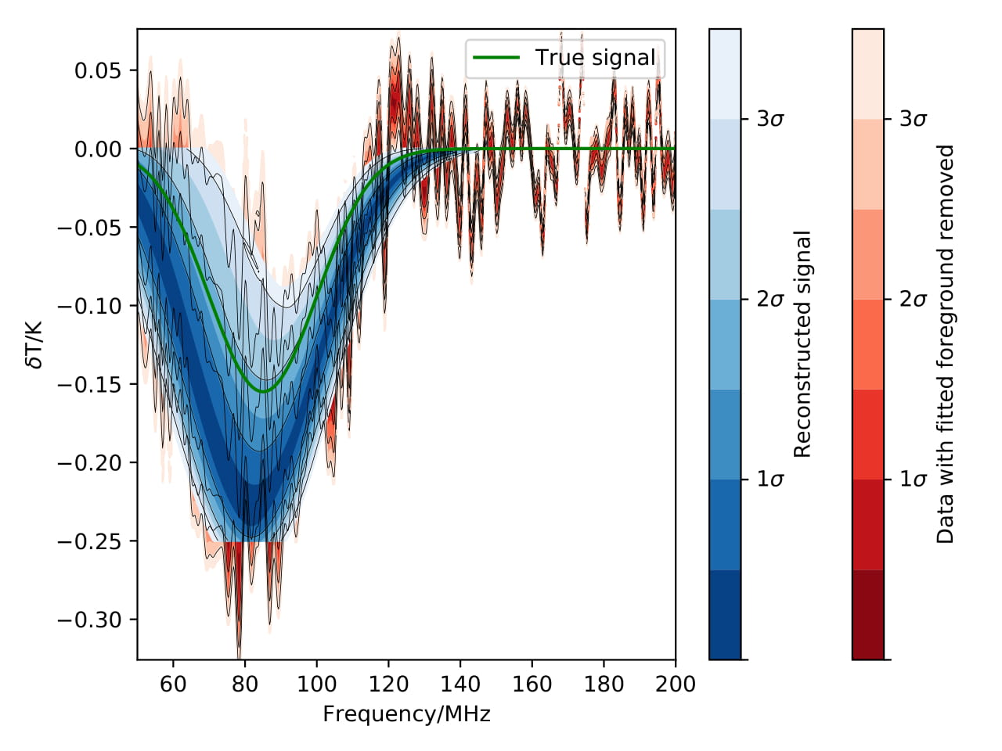
Numbers of sky regions
3 Regions
4 Regions
5 Regions
Log Spiral Antenna
Anstey et al. 2019, in prep.
Notes:
Increasing the number of sky regions allows the sky model to be more accurate to the true sky, and does result in the fit improving. Here shows fitting the same simulated dataset using 3, 4 and 5 regions. However, above a threshold where detection can be achieved, the improvement from using more regions is minimal. However, if too few regions are used, there is still enough variation in spectral index within each region to cause enough uncorrected distortion to mask the signal. The log spiral antenna was one of the best performing I have tested, and it began failing with fewer than 4 regions for this wide, 150Mhz band. This effect was typical.
Using Bayesian analysis here allows the data itself to tell you how many regions are needed by trying many different Ns and comparing evidence.

Slide 16
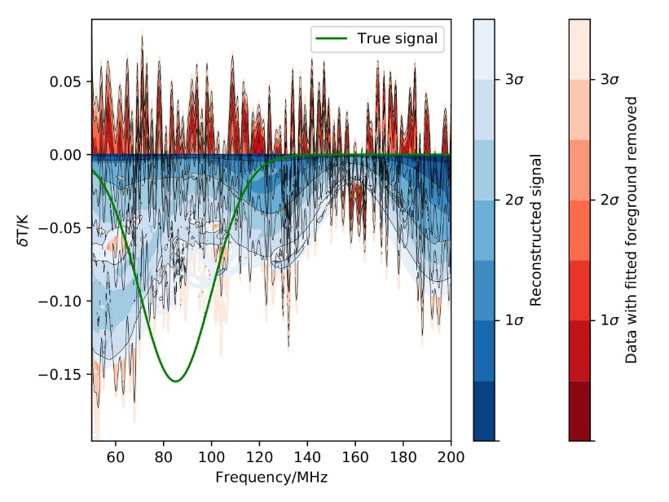
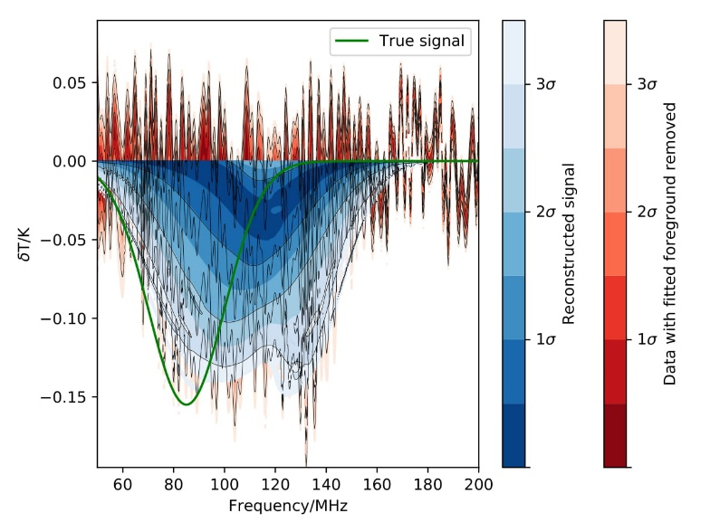
Inefficiencies
4 Regions
8 Regions
11 Regions
Conical Sinuous Antenna
Anstey et al. 2019, in prep.
Notes:
Tested conical sinuous up to N=11 (23 parameter foreground model) and it never had sufficiently accurate modelling to find the signal.

Slide 17
Summary
Even smooth, simple antennae produce enough chromatic distortion to conceal the 21cm signal when the spectral index varies
The proposed method of fitting the foregrounds via modelling can correct for this distortion sufficiently for the 21cm signal to be identified, provided the antenna is quite smooth.
Increasing the number of regions the sky model is divided into improves the quality of the chromaticity correction
The distortion cannot be accurately modelled if too few regions are used
Notes:
Read out

Slide 18


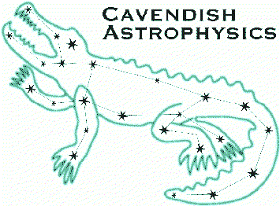















Acknowledgements
Eloy de Lera Acedo
Will Handley
John Cumner
Quentin Gueuning
Nicolas Fagnoni
Nima Razavi-Ghods
Anastasia Fialkov
Richard Hills
Paul Alexander
Kavli Institute
for Cosmology
in Cambridge
The Kavli
Foundation
Cavendish
Astrophysics
Stellenbosch
University
National Research Foundation
South African Radio
Astronomy Observatory
Cambridge
University
Imperial
College
Leibniz-Institut für
Astrophysik Potsdam
Groningen
University
Tata Institute for
Fundamental Research
University Carlos III
Madriid
Université catholique
de Louvain
Plots produced using fgivenx tool: Handley, 2018
Oxford
University
Rhodes
University
University of Malta
Sussex University

